Slide 1




REFERENCES
FINAL YEAR PROJECT
Detection of ADHD and explaining the factors
STATUS OF PAPER
WORK COMPLETED
IMPLEMENTATION
CONTENTS
Guide ATREYEE GUPTA Co-Guide DEBMITRA GHOSH
1
2
3
4
METHODOLOGY
OBJECTIVES
ABSTRACT
GAIRIK
SAJJAN
SANDIP
DAS
ARKAJYOTI
PODDAR
TAMOJIT
DASGUPTA

Slide 2
ABSTRACT
REFERENCES
In today’s world ADHD is one of the most unnoticed problems in society. This is often undetected and as a result, left undiagnosed. But, this should not be the case, as it has some serious effects on our lives. Not only in the life of the individual carrying the disorder but people surrounding them can also get affected by them, as lack of attention is there and as a result, the individual faces anger issues and may be harmful to the society. Firstly, we tried to detect ADHD with EEG brain recording data of ADHD and non-ADHD individuals using a machine learning classification algorithm. In addition we tried to explain why an instance of data is classified as something and how attributes of the data contribute to them. This study was successful in the prediction task of ADHD with an accuracy of 97% and also getting some insights to the prediction by the use of Explainable AI algorithms like LIME and SHAP.
STATUS OF PAPER
WORK COMPLETED
IMPLEMENTATION
STATISTICS
METHODOLOGY
The estimated number of children aged 3–17 years ever diagnosed with ADHD, according to US national survey of parents (2016-2019) is
6 MILLION (9.8%)
Acc. to NIMH, estimate of children with a current diagnosis of ADHD who received medication is
69.3%
ADHD prevalence in Indian children is way higher than the global estimate, at
11.32%
OBJECTIVES
ABSTRACT

Slide 3


12 SEPT 2021
REFERENCES
ADHD or Attention Deficit Hyperactivity Disorder is a common problem amongst people nowadays. If you frequently lose your keys, forget your stuff to bring to the office, are late etc. chances are high that you have ADHD. According to researches, about 10 million people have this disorder while approximately only 15-20% of people getting officially diagnosed with it.
STATUS OF PAPER
WORK COMPLETED
EFFECTS
IMPLEMENTATION
METHODOLOGY
ADHD can lead to social isolation and inability to form lasting bonds with people
ADHD can lead to procrastination, daydreaming, and depression
ADHD can lead to decreased academic, scholastic as well as job performance.
OBJECTIVES

Slide 4
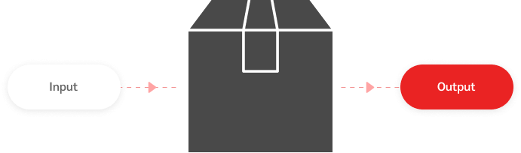

REFERENCES
STATUS OF PAPER
WORK COMPLETED
RANDOM FOREST
A tree based ensemble learning classification algorithm.
IMPLEMENTATION
METHODOLOGY
XAI
- Provides explanation for black box machine learning algorithms.
- Better insights to the prediction.

Slide 5
REFERENCES
Included the target column and put values in it as a binary classification. Only the tuples with null values were removed to avoid errors.
CLASSIFICATION
STATUS OF PAPER
We used 3 different classification algorithms :
XGBoost
KNN
Random Forest
WORK COMPLETED
DATASET
IMPLEMENTATION
DATA
PREPROCESSING
PERFORMANCE
ANALYSIS
Classifier Name | Accuracy Score(%)
XGBoost | 75.55
KNN | 84.42
Random Forest | 97.59
EEG data of ADHD and non-ADHD patients recorded during a brain controlled game. There are 5 features of the data- Theta, Alpha, Gamma, Low_Beta & High_Beta
Classifier Name | Accuracy Score(%)
XGBoost | 75.55
KNN | 84.42
Random Forest | 97.59

Slide 6
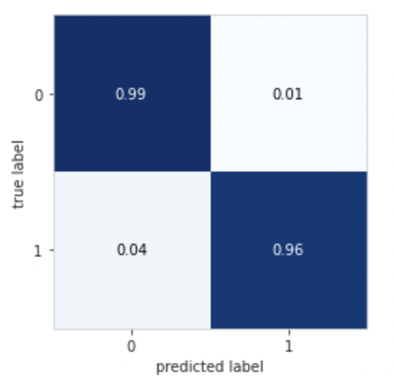
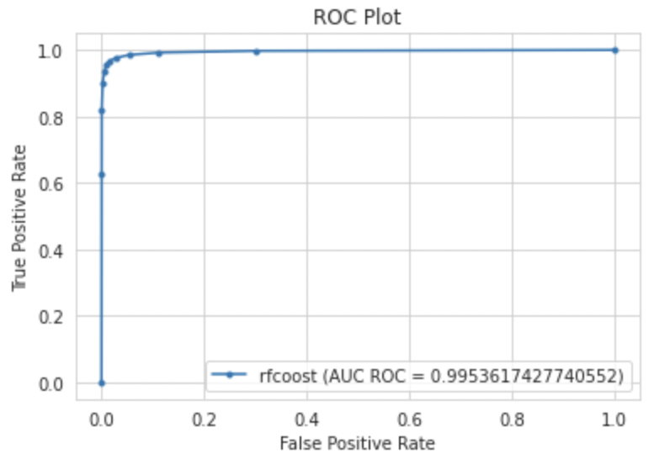
CONFUSION MATRIX
True Positive(TP) - 96%
True Negative(TN) - 99%
REFERENCES
STATUS OF PAPER
WORK COMPLETED
IMPLEMENTATION
RECEIVER OPERATING CHARACTERISTIC(ROC) CURVE
This shows a significantly good performance of the random forest algorithm used for the data. Random Forest algorithm worked perfectly for the classification task performed on the data.

Slide 7
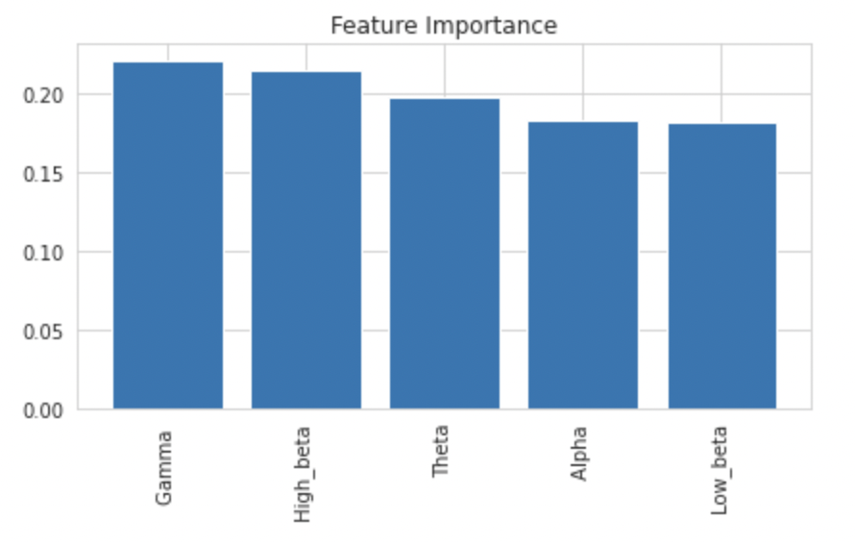


REFERENCES
SHAP
Global feature importances Highest importance- “Gamma” Lowest importance- “Low_beta”
STATUS OF PAPER
WORK COMPLETED
IMPLEMENTATION
Features that contributed the most in the prediction of two instances of data (25th and 50th)

Slide 8
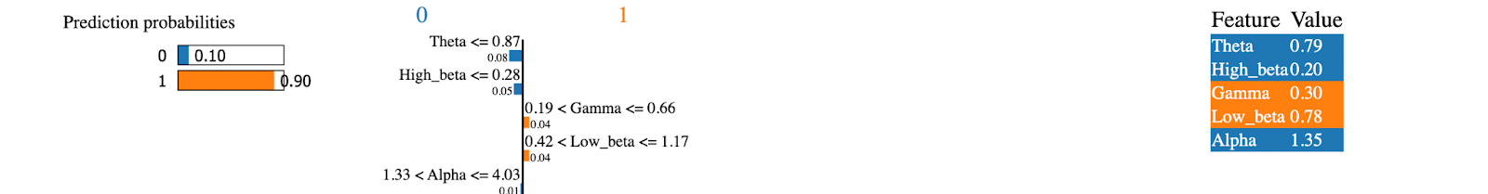
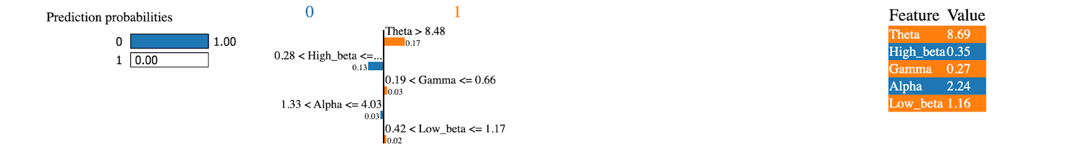
REFERENCES
LIME
Local Explanations
Why a prediction is made
How much a feature has contributed to it
STATUS OF PAPER
WORK COMPLETED
IMPLEMENTATION
Local Explanation for 25th instance

Slide 9


SUMMARY
REFERENCES
1. trained the data with 3 classification algorithms, and compared the results.
2. chose Random Forest algorithm for our classification task, as it gave best accuracy value (97%) and AUC value.
3. explained local and global effects of feature towards the classification.
4. “Gamma” contributes the most towards the prediction globally.
5. For local explanations, we used LIME and the contribution of each feature changes for different instances of the data.
STATUS OF PAPER
WORK COMPLETED
FUTURE WORK
1. Detect ADHD with facial expression
2. Find some other parameters that can help identifying ADHD

Slide 10


REFERENCES
STATUS OF PAPER
PAPER SUBMITTED

Slide 11




A. Allahverdy, M. N. Ali and R. M. Mohammad, "Detecting ADHD children using symbolic dynamic of nonlinear features of EEG", Proc. of the Conference on Electrical Engineering, 2011.
REFERENCES
A. M. Nasrabadi, A. Allahverdy, M. Samavati and M. R. Mohammadi, "EEG data for ADHD/control children", IEEE Dataport, 2020.
E. M. Valera, S. V. Faraone, K. E. Murray and L. J. Seidman, "Meta-analysis of structural imaging findings in attention-deficit/hyperactivity disorder", Biological Psychiatry, 2007.
A Tenev, S Markovska-Simoska, L Kocarev, J Pop-Jordanov, A Muller and G. Candrian, "Machine learning approach for classification of ADHD adults", Int J Psychol., 2014.
Chen H, Chen W, Song Y, Sun L, Li X (2019) “EEG characteristics of children with attention-deficit/ hyperactivity disorder.” Neuroscience 406:444–456
WEBSITES

Slide 12

THANK
YOU.
Department of Computer Science and Engineering

